Slide 1
Implementations of the ADT Stack
Chapter 7
© 2017 Pearson Education, Hoboken, NJ. All rights reserved

Slide 2
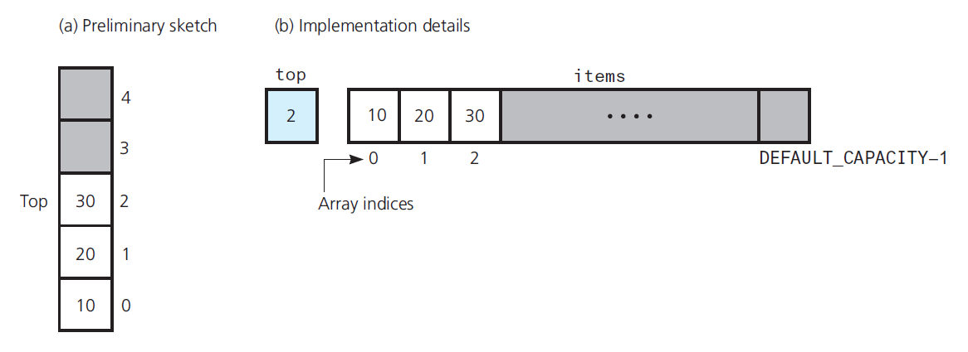
An Array-Based Implementation
FIGURE 7-1 Using an array to store a stack’s entries
© 2017 Pearson Education, Hoboken, NJ. All rights reserved

Slide 3
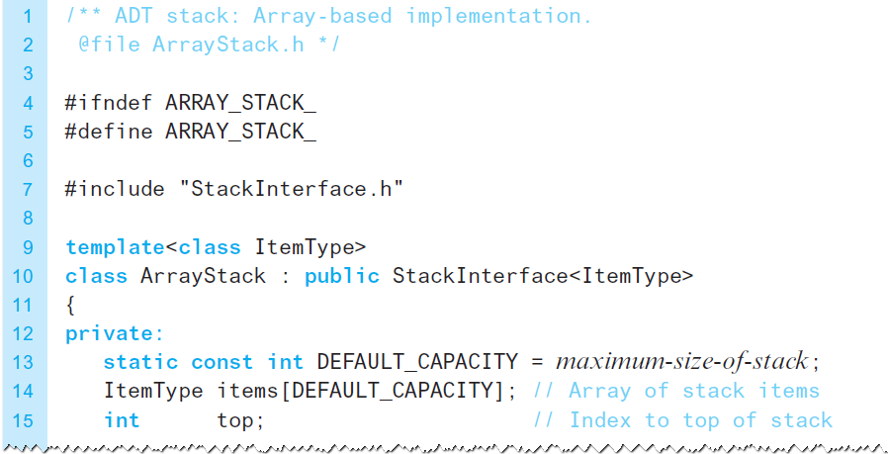
An Array-Based Implementation
Listing 7-1 The header file for an array-based stack
© 2017 Pearson Education, Hoboken, NJ. All rights reserved

Slide 4
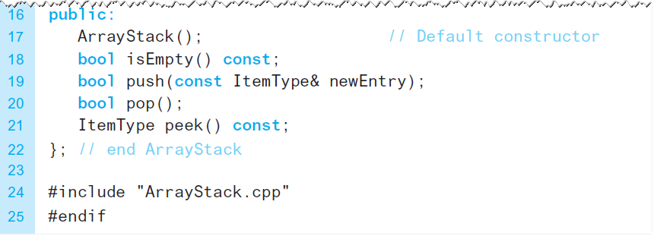
An Array-Based Implementation
Listing 7-1 The header file for an array-based stack
© 2017 Pearson Education, Hoboken, NJ. All rights reserved

Slide 5
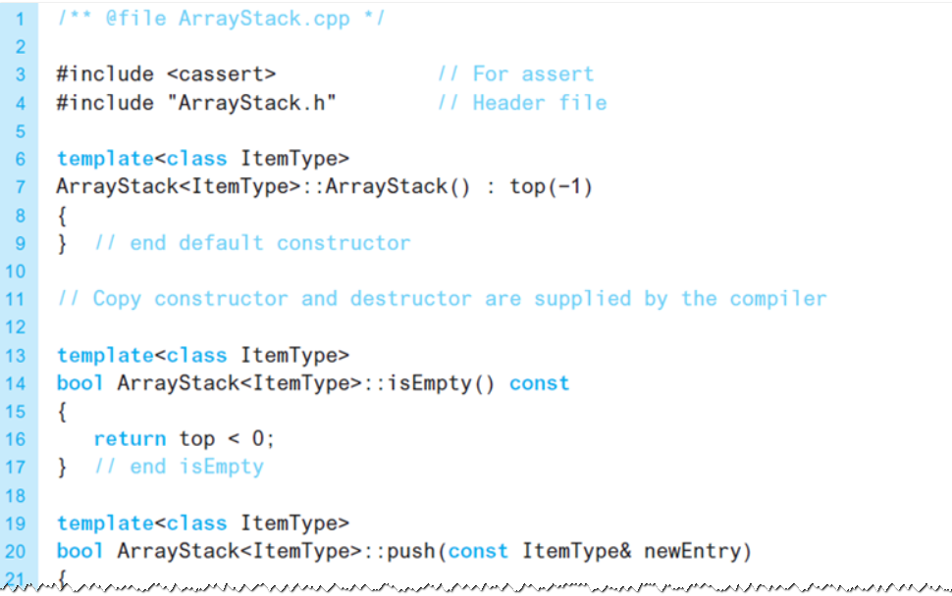
An Array-Based Implementation
LISTING 7-2 The implementation file for an array-based stack
© 2017 Pearson Education, Hoboken, NJ. All rights reserved

Slide 6
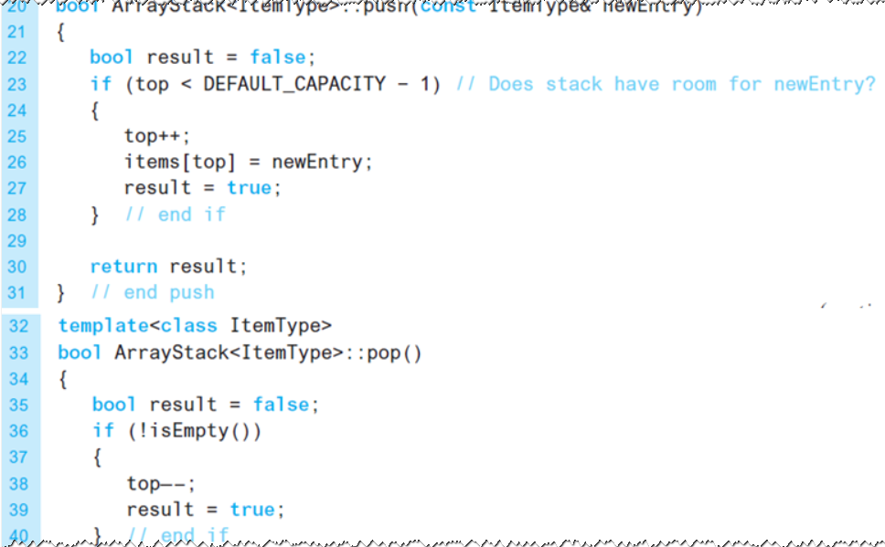
An Array-Based Implementation
LISTING 7-2 The implementation file for an array-based stack
© 2017 Pearson Education, Hoboken, NJ. All rights reserved

Slide 7
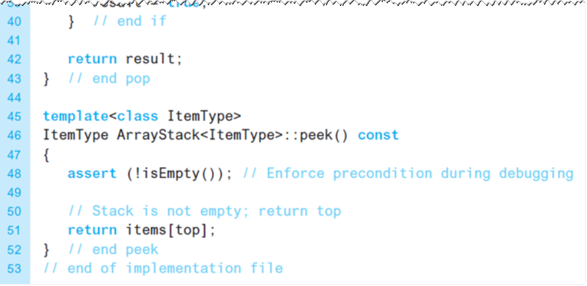
An Array-Based Implementation
LISTING 7-2 The implementation file for an array-based stack
© 2017 Pearson Education, Hoboken, NJ. All rights reserved

Slide 8
An Array-Based Implementation
Protecting the ADT’s walls
  Implement stack as a class
  Declaring items and top as private
Note
  push receives newEntry as constant reference argument
  push uses newEntry as an alias … no copy made
© 2017 Pearson Education, Hoboken, NJ. All rights reserved

Slide 9
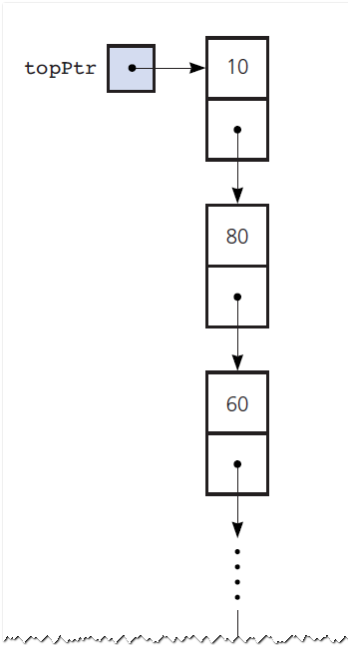
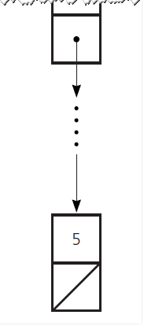
A Link-Based implementation
FIGURE 7-2 A link-based implementation of a stack
© 2017 Pearson Education, Hoboken, NJ. All rights reserved

Slide 10
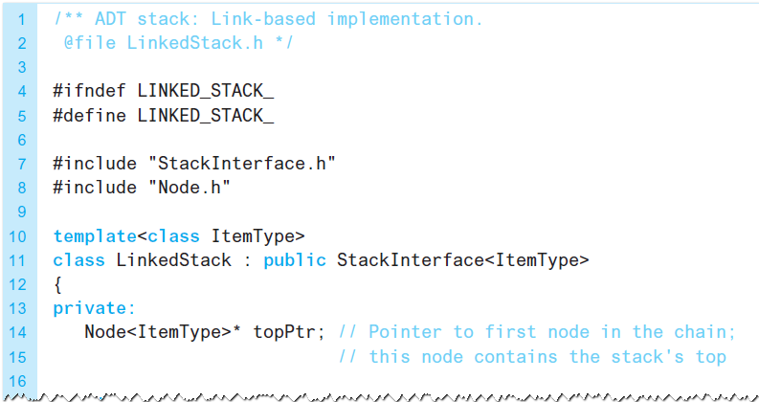
A Link-Based implementation
LISTING 7-3 The header file for the class LinkedStack
© 2017 Pearson Education, Hoboken, NJ. All rights reserved

Slide 11
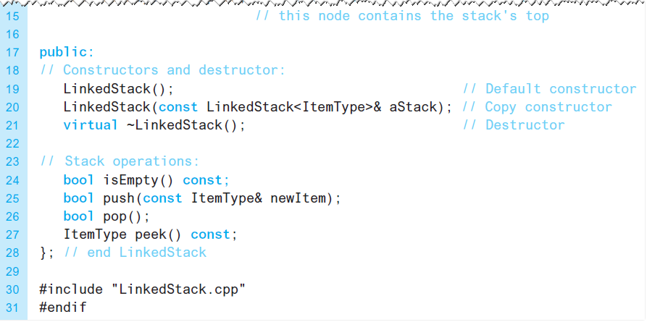
A Link-Based implementation
LISTING 7-3 The header file for the class LinkedStack
© 2017 Pearson Education, Hoboken, NJ. All rights reserved

Slide 12
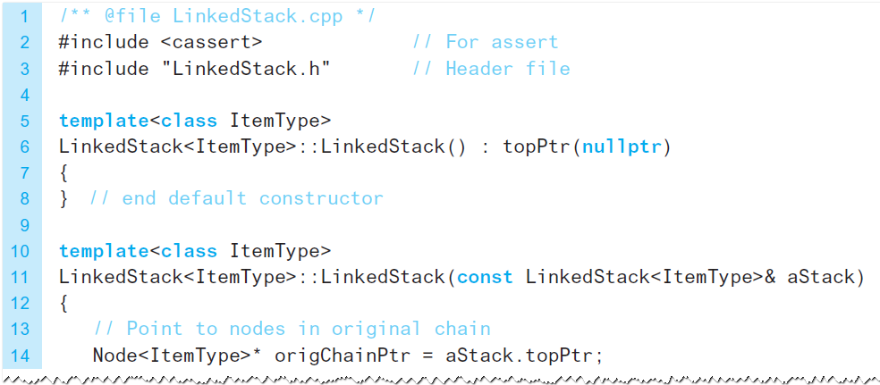
A Link-Based implementation
LISTING 7-4 The implementation file for the class LinkedStack
© 2017 Pearson Education, Hoboken, NJ. All rights reserved

Slide 13
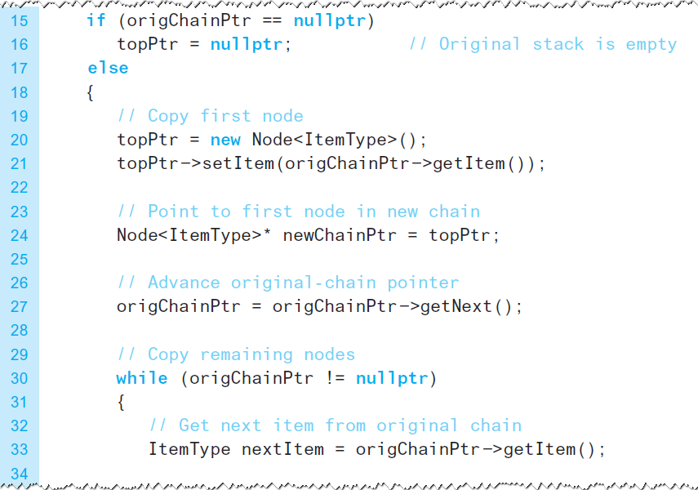
A Link-Based implementation
LISTING 7-4 The implementation file for the class LinkedStack
© 2017 Pearson Education, Hoboken, NJ. All rights reserved

Slide 14
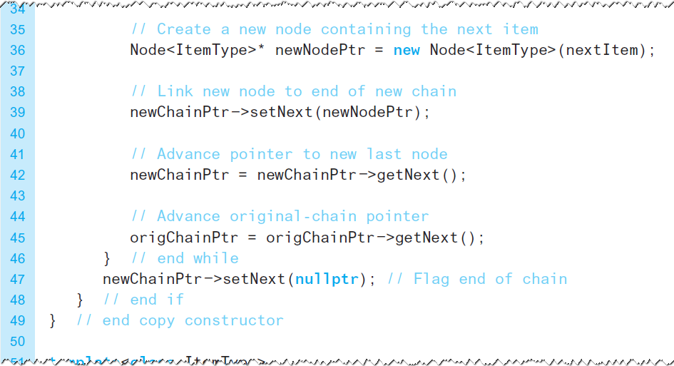
A Link-Based implementation
LISTING 7-4 The implementation file for the class LinkedStack
© 2017 Pearson Education, Hoboken, NJ. All rights reserved

Slide 15
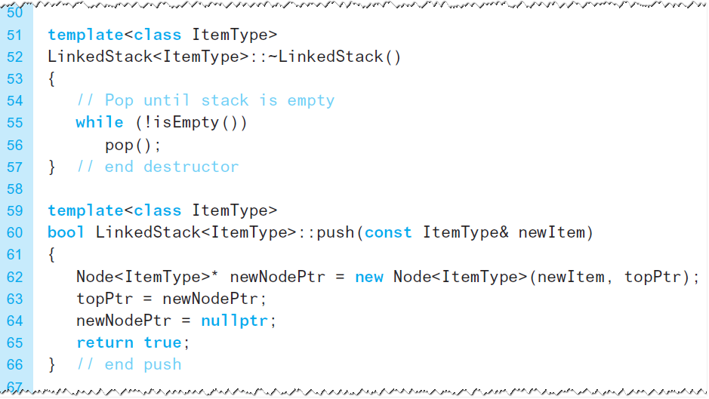
A Link-Based implementation
LISTING 7-4 The implementation file for the class LinkedStack
© 2017 Pearson Education, Hoboken, NJ. All rights reserved

Slide 16
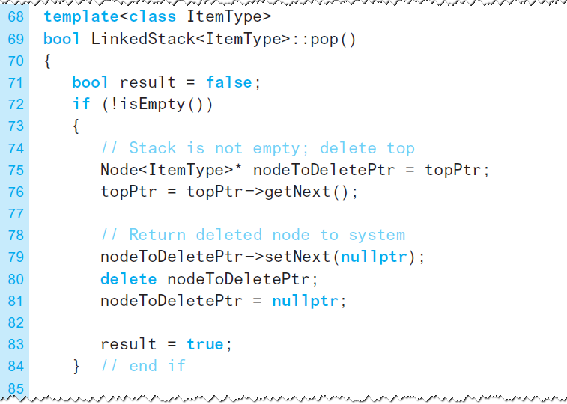
A Link-Based implementation
LISTING 7-4 The implementation file for the class LinkedStack
© 2017 Pearson Education, Hoboken, NJ. All rights reserved

Slide 17
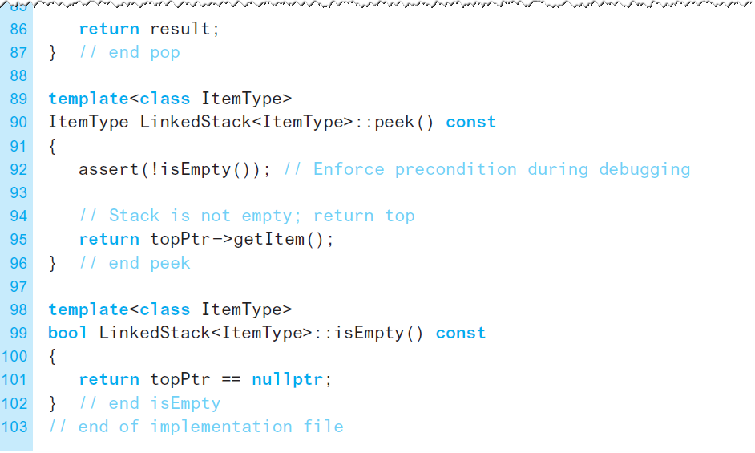
A Link-Based implementation
LISTING 7-4 The implementation file for the class LinkedStack
© 2017 Pearson Education, Hoboken, NJ. All rights reserved

Slide 18
Implementations That Use Exceptions
Method peek does not expect client to look at top of an empty stack
  assert statement merely issues error message, and halts execution
Consider having peek throw an exception
  Listings follow on next slides
© 2017 Pearson Education, Hoboken, NJ. All rights reserved

Slide 19
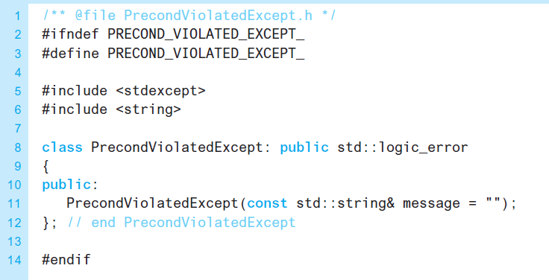
Implementations That Use Exceptions
LISTING 7-5 The header file for the class PrecondViolatedExcep
© 2017 Pearson Education, Hoboken, NJ. All rights reserved

Slide 20
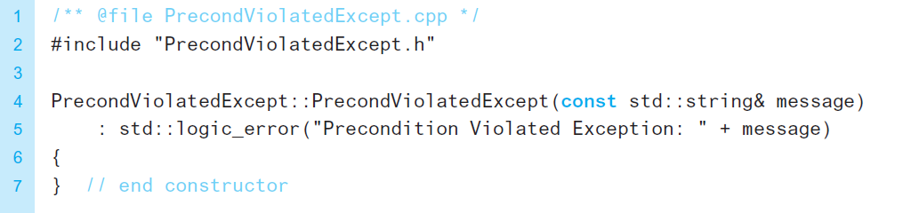
Implementations That Use Exceptions
LISTING 7-6 Implementation file for the class PrecondViolatedExcep
© 2017 Pearson Education, Hoboken, NJ. All rights reserved

Slide 21
End
Chapter 7
© 2017 Pearson Education, Hoboken, NJ. All rights reserved

